Slide 1
Challenge #2: Face Recognition
2018 Spring DLCV Final Project
ntu.dlcvta@gmail.com

Slide 2
Tasks
Task 1: Beat TA’s Baseline
Train a classifier to beat the simple/strong baseline
You will be given a dataset of interest (with predetermined data split)
You are NOT allowed to apply any external dataset or techniques like transfer learning
Task 2: Squeeze Your Model
Design a model (e.g., those with fewer parameters, simpler designs, compact or simplified versions) which would achieve comparable performances but save computation or storage costs.

Slide 3
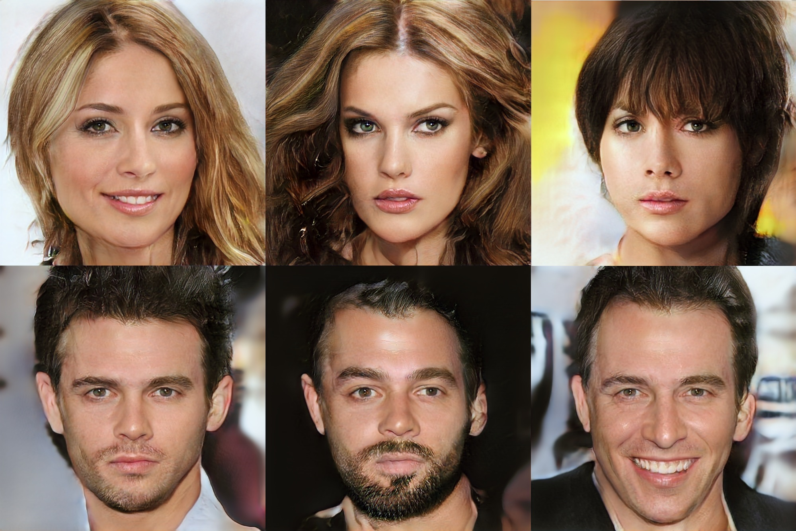
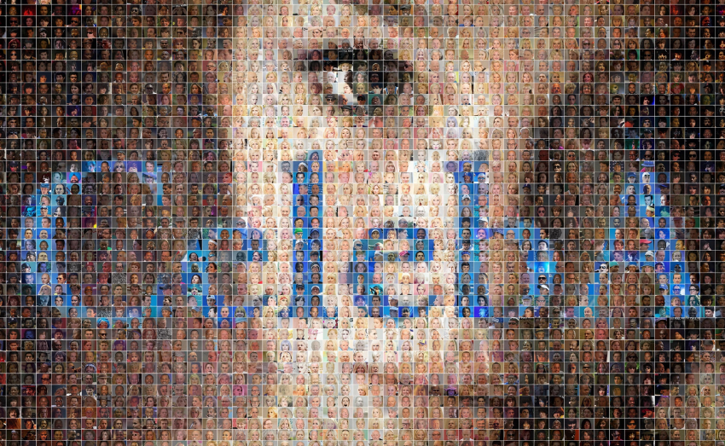
Dataset: Trimmed CelebA
CelebA Dataset
Collected by Multimedia Laboratory, The Chinese University of Hong Kong
RGB aligned face image of size 178 x 218 x 3 pixels

Slide 4
Dataset: Trimmed CelebA
Available at …
Kaggle : https://www.kaggle.com/t/e731bc01fc6440e6bcc76fdcb57a1074
Google Drive ：https://goo.gl/ugoN9J
Dataset Format
├ train/
├ val/
├ test/
├ train_id.txt
└ val_id.txt
Dataset Details
Training / Validation / Testing: 56,475 / 7,211/ 7,152 images each
2360 different identity labels

Slide 5
Experimental Settings
Part 1: Baseline Model
Use the training set (splitted by TAs)
Any external datasets and pretrained models are not allowed
Part 2: Compact Model
Design a compact model without sacrificing recognition performance remarkably.
Show your method and model in your presentation.
You should perform experiments to evaluate your methods and present the results in your presentation.

Slide 6
Kaggle Policy
Kaggle Link：[link]
Team Name: leaderStudentID_TeamName (e.g. r05901001_乂煞氣小耕乂)
Maximum Daily Submission: 10
Sample Submission:
Please refer to the SampleSubmission.csv in kaggle contest page

Slide 7
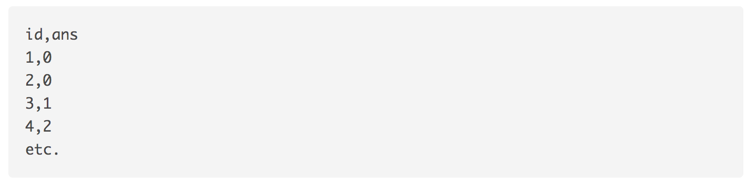
Submission Format
Please refer to SampleSubmission.csv
Note that the first line should be identical to the following example

Slide 8
Evaluation
Accuracy
Example:
m correct answers out of N images:
accuracy = m / N

Slide 9
Evaluation Methods
Final 35% + Bonus 5%
Code / Kaggle 10%: Kaggle is for reference, final accuracy will be evaluated by TAs
TA baseline (Weak Public: 5% / Strong Public: 5% / Private: 0%, No private!）
Method & Presentation 25% + Bonus 5%
Novelty + compactness + completeness of experiments (e.g., comparisons to baseline and recent models, ablation studies, etc.) 15% + Bonus 5%
Presentation (Oral + Poster) 10%
For both tasks, you need to upload your code to github and provide readme file, so that TAs will be able to reproduce your results!
If TAs cannot reproduce your results, 0 points will be given.
Intra-group evaluation will be evaluated as well!

Slide 10
Github Upload Policy
DLCV2018SPRING/final on your teamleader’s GitHub repository should include the following files:
README.md (how to reproduce your kaggle and experiment result)
Your Python files (train.py and others)
Your model files (can be loaded by your Python file)
Other script (including model downloading scipts and others)
Do NOT upload the dataset!
If TAs cannot reproduce your results due to format error, etc., no credits will be given on the corresponding task!

Slide 11
Allowed Packages（Last Modified: 6/13 13:00 p.m.）
Python 3.6
Tensorflow 1.6
Pytorch 0.4.0
Keras 2.1.5
numpy 1.14.2
pandas 0.22.0
scikit-image 0.14.0
Pillow 5.1
scipy 1.1.0
opencv-python 3.4.1.15
Ask for TAs permission if your team need to import package that hadn’t been listed on this slide; the allowed package will be updated on both FB group and challenge slide.

Slide 12
Additional References
SQUEEZENET: ALEXNET-LEVEL ACCURACY WITH 50X FEWER PARAMETERS AND <0.5MB MODEL SIZE (Forrest N. Iandola et al., ICLR’17)
https://arxiv.org/pdf/1602.07360.pdf
MobileNets: Efficient Convolutional Neural Networks for Mobile Vision Applications (Andrew G. Howard et al., arXiv17)
https://arxiv.org/pdf/1704.04861.pdf
XNOR-Net: ImageNet Classification Using Binary Convolutional Neural Networks
https://arxiv.org/pdf/1603.05279.pdf
Awesome Knowledge Distillation

Slide 13
TAs
郭子生
楊正彥
曾耕森
陳柏屺
彭懷槿
楊耀程
廖宜倫
林彥伯
If you have any questions, please leave a comment in the Facebook group or send an email to TA’s email account.

